Slide 1
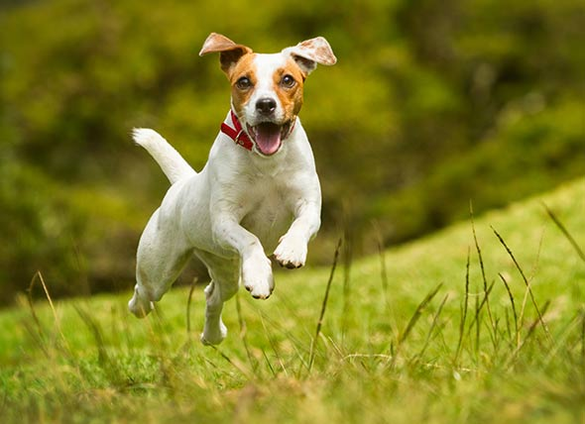
What are the physical features of a cat?
This is a Cat

Slide 2


Consider learning an image:
Some patterns are much smaller than the whole image
Can represent a small region with fewer parameters
“beak” detector

Slide 3

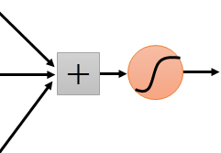
Same pattern appears in different places: They can be compressed! What about training a lot of such “small” detectors and each detector must “move around”.
“upper-left beak” detector
They can be compressed
to the same parameters.
“middle beak” detector

Slide 4
Shivaji University, Kolhapur
Department of Statistics Seminar on
“Convolutional Neural Networks”
Presented by
Sable Vinayak Machhindra MSc.II ASI Sem(IV) Under the Guidance of Dr. S.B.Mahadik
2018-2019

Slide 5
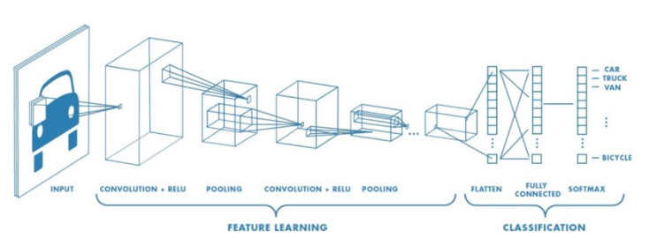
Introduction
In neural networks, Convolutional neural network (ConvNets or CNNs) is one of the main categories to do images recognition, images classifications. Objects detections, recognition faces etc., are some of the areas where CNNs are widely used.
Technically, deep learning CNN models to train and test, each input image will pass it through a series of convolution layers with filters (Kernals), Pooling, fully connected layers (FC) and apply Softmax function to classify an object with probabilistic values between 0 and 1. The below figure is a complete flow of CNN to process an input image and classifies the objects based on values.

Slide 6
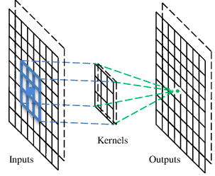
Convolutional layer
Convolution is the first layer to extract features from an input image. Convolution preserves the relationship between pixels by learning image features using small squares of input data. It is a mathematical operation that takes two inputs such as image matrix and a filter or kernal
Beak detector
A filter

Slide 7
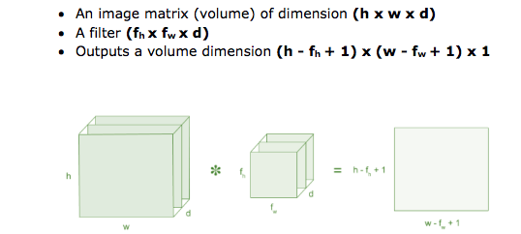

Convolution

Slide 8
How it work
These are the network parameters to be learned.
1 | -1 | -1
-1 | 1 | -1
-1 | -1 | 1
1 | 0 | 0 | 0 | 0 | 1
0 | 1 | 0 | 0 | 1 | 0
0 | 0 | 1 | 1 | 0 | 0
1 | 0 | 0 | 0 | 1 | 0
0 | 1 | 0 | 0 | 1 | 0
0 | 0 | 1 | 0 | 1 | 0
Filter 1
-1 | 1 | -1
-1 | 1 | -1
-1 | 1 | -1
Filter 2
……
6 x 6 image
Each filter detects a small pattern (3 x 3).

Slide 9
1 | -1 | -1
-1 | 1 | -1
-1 | -1 | 1
Filter 1
stride=1
1 | 0 | 0 | 0 | 0 | 1
0 | 1 | 0 | 0 | 1 | 0
0 | 0 | 1 | 1 | 0 | 0
1 | 0 | 0 | 0 | 1 | 0
0 | 1 | 0 | 0 | 1 | 0
0 | 0 | 1 | 0 | 1 | 0
Dot
product
3
-1
6 x 6 image

Slide 10
1 | -1 | -1
-1 | 1 | -1
-1 | -1 | 1
Filter 1
If stride=2
1 | 0 | 0 | 0 | 0 | 1
0 | 1 | 0 | 0 | 1 | 0
0 | 0 | 1 | 1 | 0 | 0
1 | 0 | 0 | 0 | 1 | 0
0 | 1 | 0 | 0 | 1 | 0
0 | 0 | 1 | 0 | 1 | 0
3
-3
6 x 6 image

Slide 11
1 | -1 | -1
-1 | 1 | -1
-1 | -1 | 1
Filter 1
stride=1
1 | 0 | 0 | 0 | 0 | 1
0 | 1 | 0 | 0 | 1 | 0
0 | 0 | 1 | 1 | 0 | 0
1 | 0 | 0 | 0 | 1 | 0
0 | 1 | 0 | 0 | 1 | 0
0 | 0 | 1 | 0 | 1 | 0
3
-1
-3
-1
-3
1
0
-3
-3
-3
0
1
3
-2
-2
-1
6 x 6 image

Slide 12
-1 | 1 | -1
-1 | 1 | -1
-1 | 1 | -1
Filter 2
stride=1
Repeat this for each filter
1 | 0 | 0 | 0 | 0 | 1
0 | 1 | 0 | 0 | 1 | 0
0 | 0 | 1 | 1 | 0 | 0
1 | 0 | 0 | 0 | 1 | 0
0 | 1 | 0 | 0 | 1 | 0
0 | 0 | 1 | 0 | 1 | 0
3
-1
-3
-1
-1
-1
-1
-1
-3
1
0
-3
-1
-1
-2
1
Feature
Map
-3
-3
0
1
-1
-1
-2
1
3
-2
-2
-1
6 x 6 image
-1
0
-4
3
Two 4 x 4 images
Forming 2 x 4 x 4 matrix

Slide 13
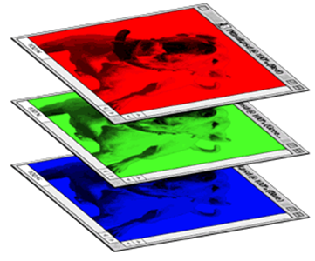
Color image: RGB 3 channels
1 | -1 | -1
-1 | 1 | -1
-1 | -1 | 1
-1 | 1 | -1
-1 | 1 | -1
-1 | 1 | -1
1 | -1 | -1
-1 | 1 | -1
-1 | -1 | 1
-1 | 1 | -1
-1 | 1 | -1
-1 | 1 | -1
1 | -1 | -1
-1 | 1 | -1
-1 | -1 | 1
-1 | 1 | -1
-1 | 1 | -1
-1 | 1 | -1
Filter 1
Filter 2
Color image
1 | 0 | 0 | 0 | 0 | 1
0 | 1 | 0 | 0 | 1 | 0
0 | 0 | 1 | 1 | 0 | 0
1 | 0 | 0 | 0 | 1 | 0
0 | 1 | 0 | 0 | 1 | 0
0 | 0 | 1 | 0 | 1 | 0
1 | 0 | 0 | 0 | 0 | 1
0 | 1 | 0 | 0 | 1 | 0
0 | 0 | 1 | 1 | 0 | 0
1 | 0 | 0 | 0 | 1 | 0
0 | 1 | 0 | 0 | 1 | 0
0 | 0 | 1 | 0 | 1 | 0
1 | 0 | 0 | 0 | 0 | 1
0 | 1 | 0 | 0 | 1 | 0
0 | 0 | 1 | 1 | 0 | 0
1 | 0 | 0 | 0 | 1 | 0
0 | 1 | 0 | 0 | 1 | 0
0 | 0 | 1 | 0 | 1 | 0

Slide 14
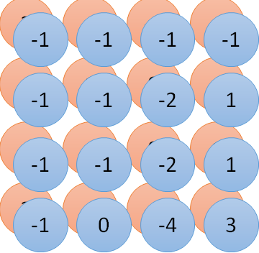
Convolution v.s. Fully Connected
1 | 0 | 0 | 0 | 0 | 1
0 | 1 | 0 | 0 | 1 | 0
0 | 0 | 1 | 1 | 0 | 0
1 | 0 | 0 | 0 | 1 | 0
0 | 1 | 0 | 0 | 1 | 0
0 | 0 | 1 | 0 | 1 | 0
1 | -1 | -1
-1 | 1 | -1
-1 | -1 | 1
-1 | 1 | -1
-1 | 1 | -1
-1 | 1 | -1
convolution
image
1 | 0 | 0 | 0 | 0 | 1
0 | 1 | 0 | 0 | 1 | 0
0 | 0 | 1 | 1 | 0 | 0
1 | 0 | 0 | 0 | 1 | 0
0 | 1 | 0 | 0 | 1 | 0
0 | 0 | 1 | 0 | 1 | 0
Fully-connected
……
……

Slide 15
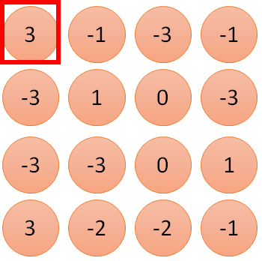
1 | -1 | -1
-1 | 1 | -1
-1 | -1 | 1
1
1
Filter 1
2
0
3
0
3
4:
0
1 | 0 | 0 | 0 | 0 | 1
0 | 1 | 0 | 0 | 1 | 0
0 | 0 | 1 | 1 | 0 | 0
1 | 0 | 0 | 0 | 1 | 0
0 | 1 | 0 | 0 | 1 | 0
0 | 0 | 1 | 0 | 1 | 0
…
0
8
1
9
0
10:
0
…
13
0
6 x 6 image
14
0
fewer parameters!
15
Only connect to 9 inputs, not fully connected
1
16
1
…

Slide 16
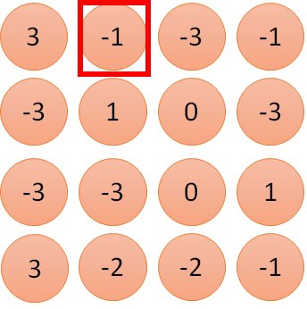
1 | -1 | -1
-1 | 1 | -1
-1 | -1 | 1
1:
1
Filter 1
2:
0
3:
0
3
4:
0
1 | 0 | 0 | 0 | 0 | 1
0 | 1 | 0 | 0 | 1 | 0
0 | 0 | 1 | 1 | 0 | 0
1 | 0 | 0 | 0 | 1 | 0
0 | 1 | 0 | 0 | 1 | 0
0 | 0 | 1 | 0 | 1 | 0
…
7:
0
8:
1
-1
9:
0
10:
0
…
13:
0
6 x 6 image
14:
0
Fewer parameters
15:
1
16:
1
Shared weights
Even fewer parameters
…

Slide 17
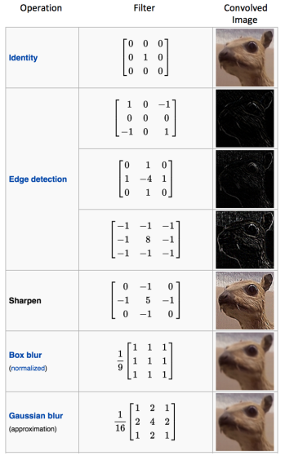
Types of filters (Kernels)
Convolution of an image with different filters can perform operations such as edge detection, blur and sharpen by applying filters. The below example shows various convolution image after applying different types of filters (Kernels).

Slide 18
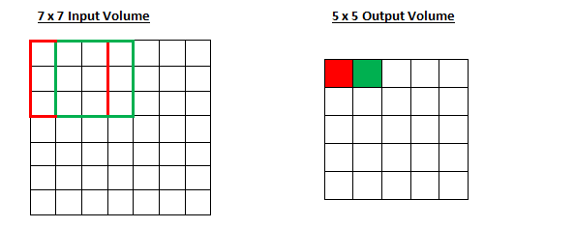
Stride and Padding
Now, there are 2 main parameters that we can change to modify the behavior of each layer. After we choose the filter size, we also have to choose the stride and the padding.
Stride controls how the filter convolves around the input volume. the filter convolves around the input volume by shifting one unit at a time. The amount by which the filter shifts is the stride. In that case, the stride was implicitly set at 1. Stride is normally set in a way so that the output volume is an integer and not a fraction. Let’s look at an example. Let’s imagine a 7 x 7 input volume, a 3 x 3 filter (Disregard the 3rd dimension for simplicity), and a stride of 1. This is the case that we’re accustomed to.

Slide 19
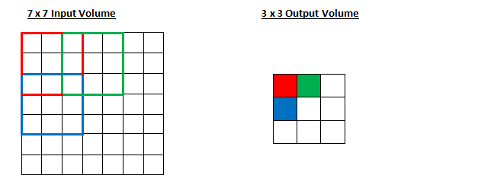
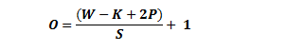
See if you can try to guess what will happen to the output volume as the stride increases to 2.
Notice that if we tried to set our stride to 3, then we’d have issues with spacing and making sure the receptive fields fit on the input volume. Normally, programmers will increase the stride if they want receptive fields to overlap less and if they want smaller spatial dimensions.
The formula for calculating the output size for any given conv layer is:
where O is the output height/length,
W is the input height/length,
K is the filter size,
P is the padding,
S is the stride.

Slide 20
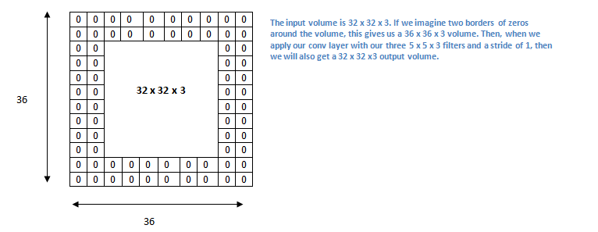
What happens when you apply three 5 x 5 x 3 filters to a 32 x 32 x 3 input volume….????
Let’s say we want to apply the same conv layer but we want the output volume to remain 32 x 32 x 3. To do this, we can apply a zero padding of size 2 to that layer. Zero padding pads the input volume with zeros around the border. If we think about a zero padding of two, then this would result in a 36 x 36 x 3 input volume.

Slide 21
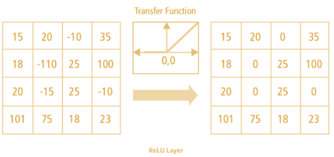
ReLU (Rectified Linear Units) Layers
After each conv layer, it is convention to apply a nonlinear layer (or activation layer) immediately afterward. The purpose of this layer is to introduce nonlinearity to a system that basically has just been computing linear operations during the conv layers (just element wise multiplications and summations).In the past, nonlinear functions like tanh and sigmoid were used, but researchers found out that ReLU layers work far better because the network is able to train a lot faster (because of the computational efficiency) without making a significant difference to the accuracy.
ReLU (Rectified Linear Units) activation function is
ƒ(x) = max(0,x)

Slide 22
Pooling Layer
Pooling layers section would reduce the number of parameters when the images are too large. Spatial pooling also called subsampling or downsampling which reduces the dimensionality of each map but retains the important information. Spatial pooling can be of different types:
Max Pooling
Average Pooling
Sum Pooling
After some ReLU layers, programmers may choose to apply a pooling layer. It is also referred to as a downsampling layer. In this category, there are also several layer options, with max pooling being the most popular. This basically takes a filter (normally of size 2x2) and a stride of the same length. It then applies it to the input volume and outputs the maximum number in every sub region that the filter convolves around.

Slide 23
Max Pooling
1 | -1 | -1
-1 | 1 | -1
-1 | -1 | 1
-1 | 1 | -1
-1 | 1 | -1
-1 | 1 | -1
Filter 1
Filter 2
3
-1
-3
-1
-1
-1
-1
-1
-3
1
0
-3
-1
0
-1
-2
1
-3
-3
0
1
-1
-1
-2
1
3
-2
-2
-1
-1
0
-4
3

Slide 24


Why Pooling
Subsampling pixels will not change the object
bird
bird
Subsampling
We can subsample the pixels to make image smaller
fewer parameters to characterize the image

Slide 25
A CNN compresses a fully connected network in two ways:
Reducing number of connections
Shared weights on the edges
Max pooling further reduces the complexity

Slide 26


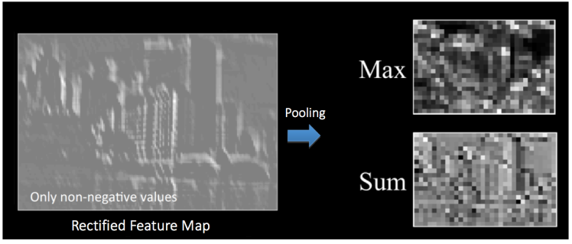
Input
Convolution
ReLU
Can repeat many times
Max Pooling

Slide 27

Flattening
3
0
1
3
0
0
1
3
3
1
0
0
3
Flattened
1
Fully Connected Feedforward network
0
3

Slide 28
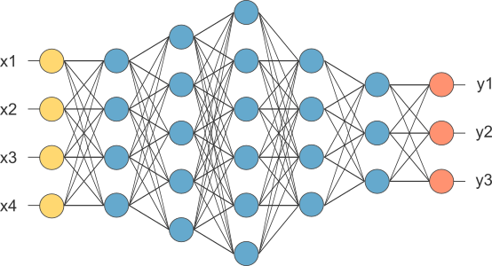
Fully Connected Layer
The layer we call as FC layer, we flattened our matrix into vector and feed it into a fully connected layer like neural network.
The output from the convolutional and pooling layers represent high-level features of the input image. The purpose of the Fully Connected layer is to use these features for classifying the input image into various classes based on the training dataset.
The sum of output probabilities from the Fully Connected Layer is 1. This is ensured by using the Softmax as the activation function in the output layer of the Fully Connected Layer. The Softmax function takes a vector of arbitrary real-valued scores and squashes it to a vector of values between zero and one that sum to one.

Slide 29
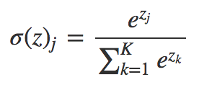
Softmax Activation Function
Softmax is an activation function. Other activation functions include RELU and Sigmoid. It is frequently used in classifications. Softmax output is large if the score (input called logit) is large.
Softmax Activation Function is:
If we take an input of [1,2,3,4,1,2,3], the softmax of that is [0.024, 0.064, 0.175, 0.475, 0.024, 0.064, 0.175].
The softmax function highlights the largest values and suppress other values.
Comparing to “max” function, softmax is differentiable.

Slide 30
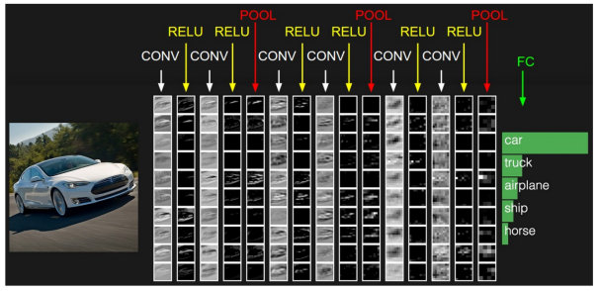
Putting it all together – Training using Backpropagation
As discussed above, the Convolution + Pooling layers act as Feature Extractors from the input image while Fully Connected layer acts as a classifier.

Slide 31
Application
Image Recognition
Video Analysis
Natural Language Processing
Drug Discovery
Health Risk Assessment And Biomarkers Of Aging Discovery
Checkers Game
Speech Recognition

Slide 32
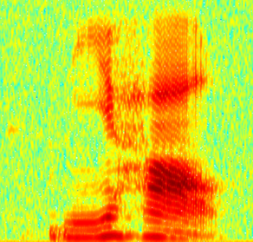
CNN in speech recognition
The filters move in the frequency direction.
CNN
Frequency
Image
Time
Spectrogram

Slide 33
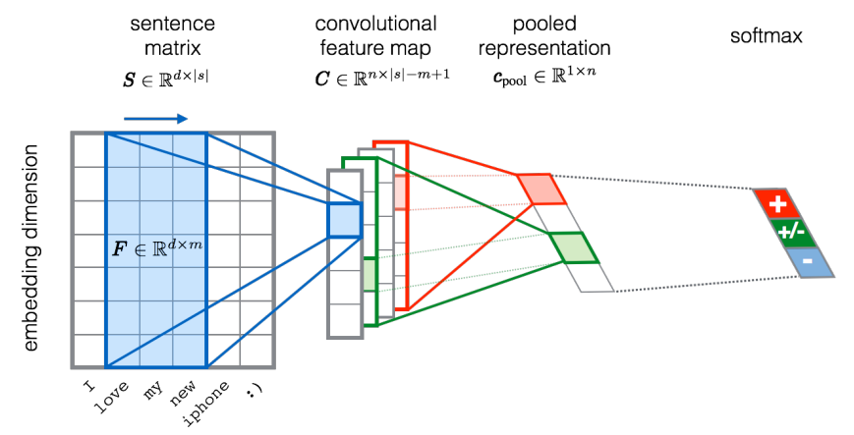
CNN in text classification
?

Slide 34
References:
Keiron O’Shea and Ryan Nash : An Introduction to Convolutional Neural Networks
https://ujjwalkarn.me/2016/08/11/intuitive-explanation-convnets/

Slide 35
Thank you......

